Slide 1
Khan Academy
Grades 9, 10 and 11 take the PSAT on October 19th
Log in and practice Math, English and Reading
Practice, Practice, Practice

Slide 2
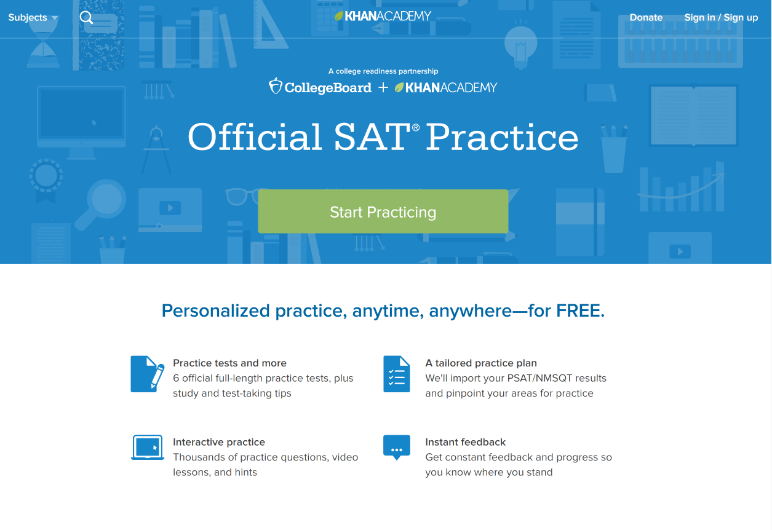
www.satpractice.com

Slide 3
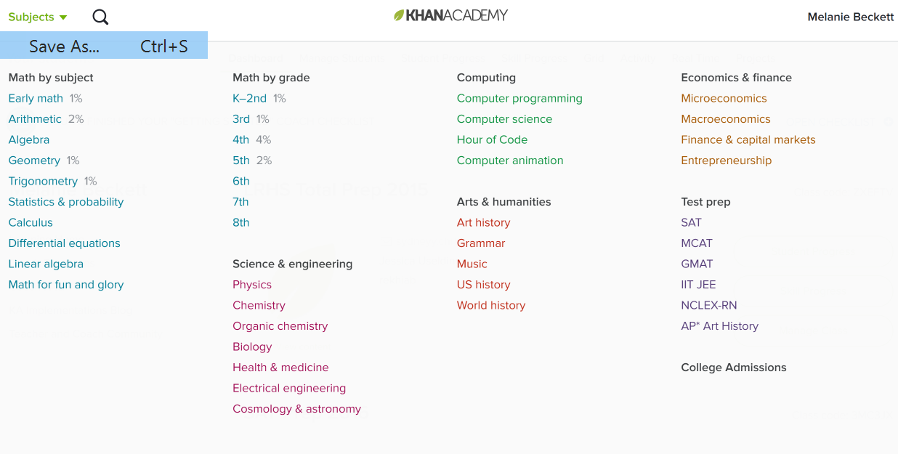

Slide 4
Wanna take the free practice test?

Slide 5
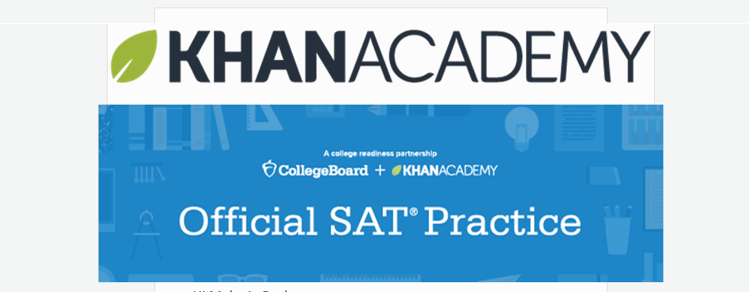
Official Practice Test Day for PSAT/NMSQT Saturday, October 8th

Slide 6
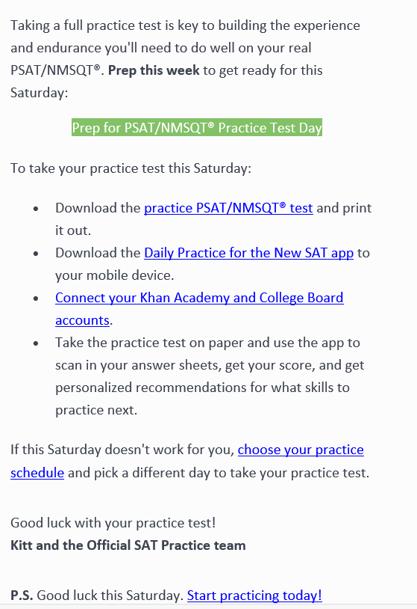
Follow these steps to see what areas of practice are needed for October 19th:
Download the Practice Test
Print the test
Download the Daily Practice for the New SAT APP on your iPad
Connect your Khan Academy and College Board Accounts
TAKE the test and USE the app to SCAN your answer sheet
GET your score and GET personalized recommendations for last minute skills practice

