Slide 1

Intimidate the competition
D
E
B
A
T
E
L EGACY
T
E
A
M
Debate This !

Slide 2
Debate Team
Meets Every
Thursday
3:00 PM

Slide 3



Head
To Head
Competition

Slide 4

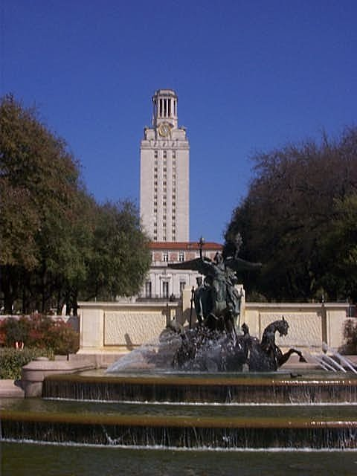
University of Texas at Austin

Slide 5
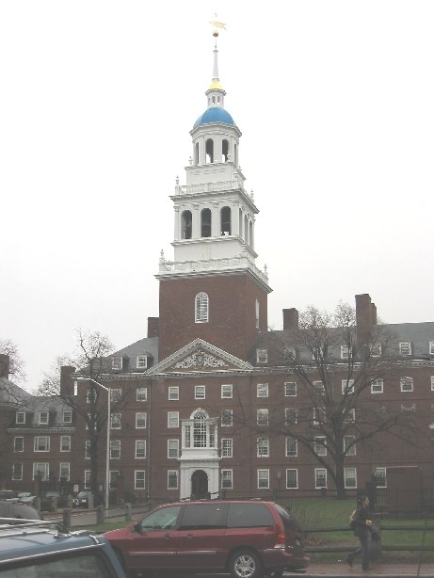


Slide 6
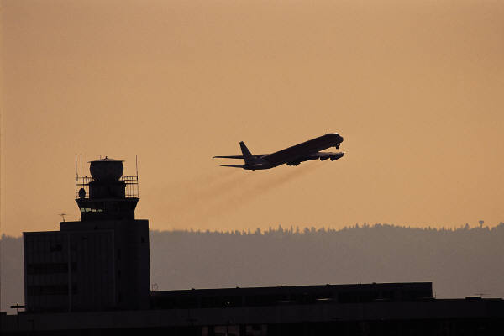
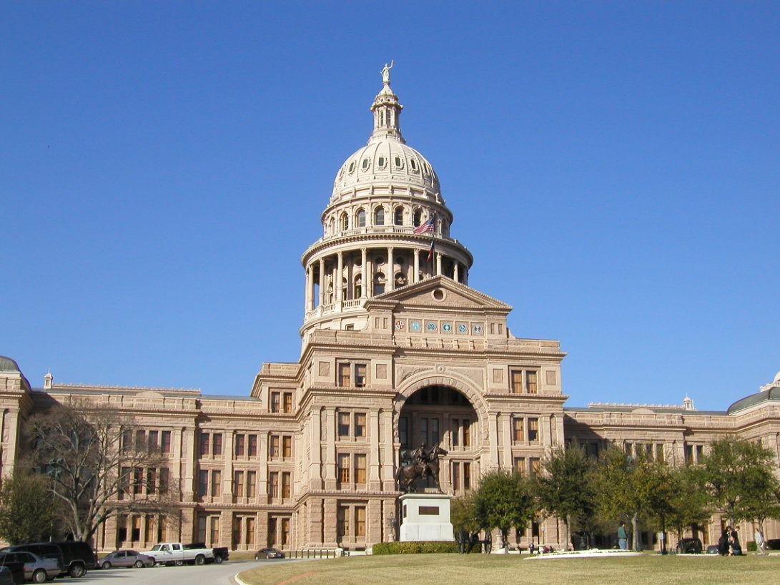


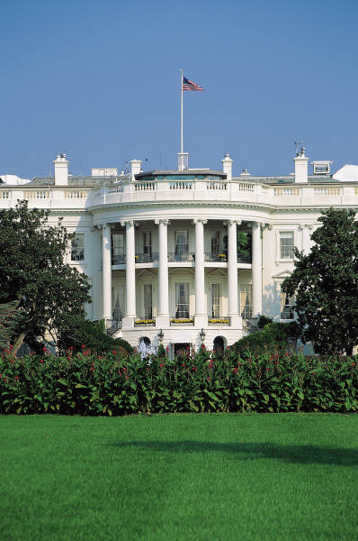
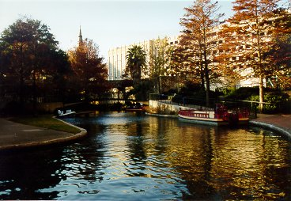
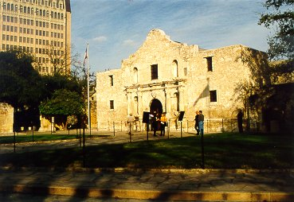
Debate Over the U.S.

Slide 7
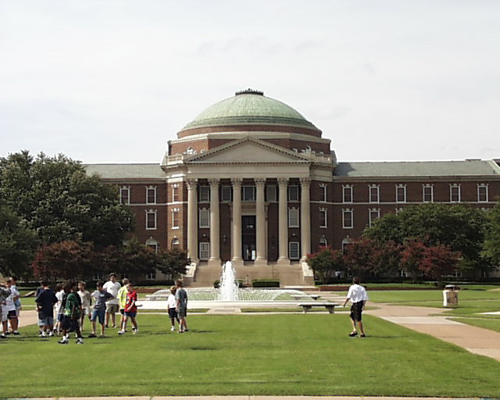
Southern Methodist University
Earn Scholarships

Slide 8

Political Activists

Slide 9


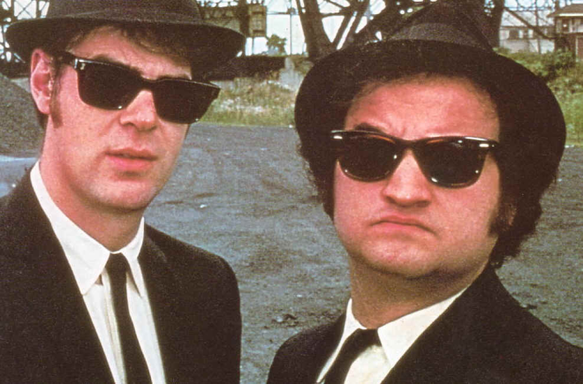
The Truth is not
Alien…
To
Those Who Debate It.
BHS Debate Team

Slide 10

Legacy High School
Debate Team
LHS
Changing the World
One Opinion at a time!!!

Slide 11
Drug testing every student
Invading your privacy to keep us Safe????
The 4th amendment vs.????

Slide 12
Debate Team
Meets Every
Thursday
3 PM

Slide 13
Economic development ought to take precedence over the Environment????
Are you willing to give up some of your liberty to promote National Security????

Slide 14
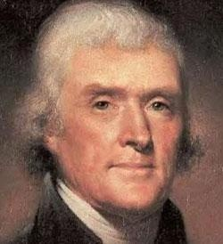
Defending the Constitution is it worth protecting?????

Slide 15
Think Again
Legacy HS DEBATE
Legacy HS DEBATE
Philosophy

Slide 16
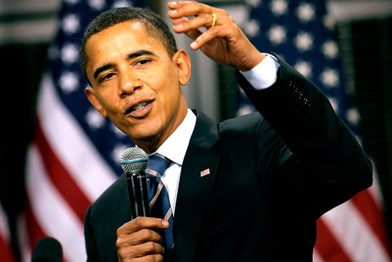
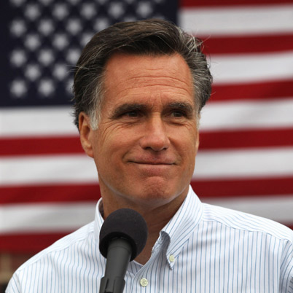
Who is
Right w ho is Left

Slide 17
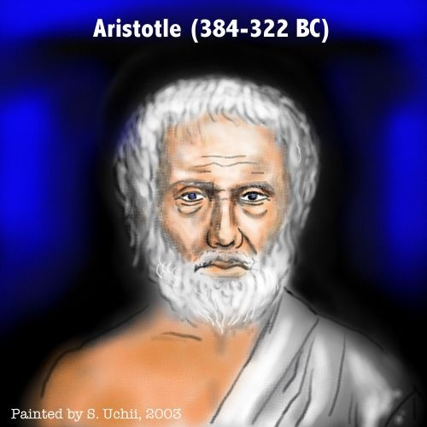
Is Truth more important than Wisdom ???

Slide 18
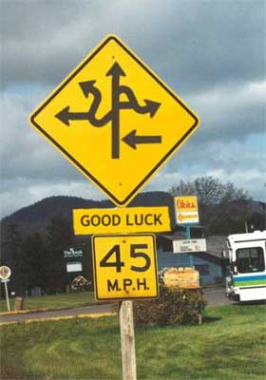
F
I
N
D
I
N
G
T
R
U
T
H
To Truth

Slide 19
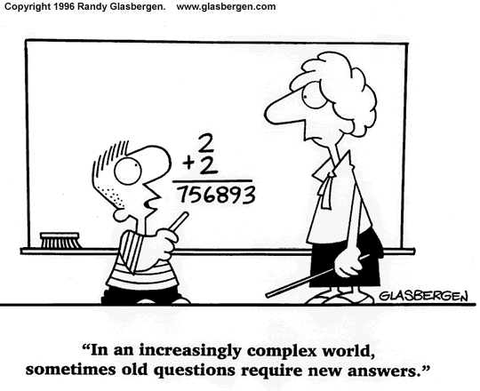

Slide 20
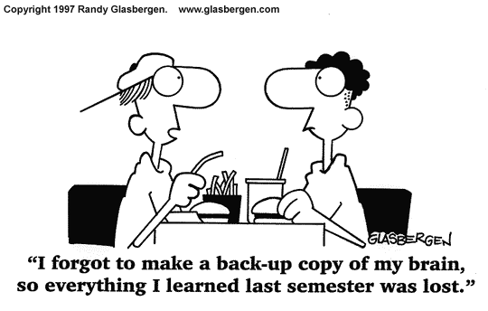

Slide 21
TRUST THOSE
WHO
SEEK THE TRUTH
DOUBT THOSE
WHO
SAY THEY FOUND IT!

Slide 22
Debate Team
Meets Every
Thursday
3 PM

